Slide 1
UPPER SIXTH ARTS
GEOGRAPHY
Further Study 7
Tourism Development in Cameroon
Notes:
Good morning, class, and welcome to our geography lesson. I am your geography teacher, Mr Kamdem. Today we are starting Further Study 7: Tourism Development in Cameroon.

Slide 2
CLASS INFO
Class, Chapter and Duration
Class | Upper Sixth Arts
Chapter | Module 6: Understanding and managing the dynamics of economic activities across the world in general and Cameroon in particular
Duration | 2 periods (2 × 50 minutes)
Notes:
This lesson is for Upper Sixth Arts. It belongs to Module 6: Understanding and managing the dynamics of economic activities across the world in general and Cameroon in particular. We shall need 2 periods to cover it.

Slide 3
IDENTIFICATION
Lesson Identification
Topic | Geography of Cameroon
Sub-topic | Tourism in Cameroon
Lesson | Further Study 7: Tourism Development in Cameroon
Notions / Concepts | Tourist resource, national park, hotel, tourist circuit, Ministry of Tourism.
Syllabus focus | Natural and human resources and their distribution; tourist infrastructure; sources and destinations; problems; measures by individuals, communities and government; impacts.
Competence | Learners are able to describe tourism in Cameroon, its problems and ways to promote it.
Notes:
Our topic is Geography of Cameroon, and the sub-topic is Tourism in Cameroon. The key notions we shall use today are: tourist resource, national park, hotel, tourist circuit, Ministry of Tourism. At the end, you should be able to do this: learners are able to describe tourism in Cameroon, its problems and ways to promote it.

Slide 4

HOMEWORK CORRECTION
Correction of the Homework
Question (Lesson 31: Tourism):
Choose a tourist site in Cameroon and place it on a stage of Butler's model.
Notes:
Before we start the new lesson, let us correct the homework I gave you at the end of Lesson 31: Tourism. The question was: Choose a tourist site in Cameroon and place it on a stage of Butler's model. Take out your exercise books.

Slide 5
HOMEWORK CORRECTION
Correction: Possible Answer
Example: Kribi is at the development stage (new hotels, the deep-sea port and the tarred road bring more visitors). Limbe beaches may be near consolidation; Waza, hit by insecurity, is in decline.
Notes:
Here is a good answer. Example: Kribi is at the development stage (new hotels, the deep-sea port and the tarred road bring more visitors). Limbe beaches may be near consolidation; Waza, hit by insecurity, is in decline. Compare it with your own answer and correct your work in red.

Slide 6
LESSON PLAN
Lesson Plan
Correction of the homework
Objectives and recall
Real-life situation and action to take
Learning activities
Board summary
Evaluation, remediation and homework
Notes:
Here is the plan of our lesson today. First, we shall correct the homework. Then we shall look at the objectives and recall what you already know. After that, we shall study a situation from real life and the action to take, and do the learning activities. Finally, we shall copy the board summary, do the evaluation and the remediation, and I will give you the homework.

Slide 7
OBJECTIVES
Objectives
By the end of this lesson, you should be able to:
Describe the tourist resources and infrastructure of Cameroon.
Explain the problems of tourism.
Notes:
Take your time to copy this part; we will continue together.

Slide 8
OBJECTIVES
Objectives (continued)
Propose measures to promote tourism and assess its impacts.
Notes:
By the end of this lesson, you should be able to do three things. Number 1: describe the tourist resources and infrastructure of Cameroon. Number 2: explain the problems of tourism. Number 3: propose measures to promote tourism and assess its impacts.

Slide 9
PREVIOUS KNOWLEDGE
Previous Knowledge
Cameroon is called "Africa in miniature".
Tourism brings jobs and money.
Notes:
Let us first remember what you already know. Cameroon is called "Africa in miniature". Tourism brings jobs and money. Keep this in mind, because we shall build on it today.

Slide 10
REAL-LIFE SITUATION
Situation in Real Life
Cameroon has beaches, mountains, parks and many cultures, yet it receives fewer tourists than Kenya or Morocco. The Ministry of Tourism wants to attract more visitors.
Notes:
Listen carefully to this situation from real life. Cameroon has beaches, mountains, parks and many cultures, yet it receives fewer tourists than Kenya or Morocco. The Ministry of Tourism wants to attract more visitors. Think about it, because I am going to ask you some questions.

Slide 11
REAL-LIFE SITUATION
Situation: Question 1
What is the problem in the situation?
Notes:
Question 1: What is the problem in the situation? Think for a moment, then raise your hand to answer.

Slide 12
REAL-LIFE SITUATION
Answer
Cameroon has great potential but few tourists.
Notes:
Good. Cameroon has great potential but few tourists.

Slide 13
REAL-LIFE SITUATION
Situation: Question 2
Why is Cameroon called "Africa in miniature"?
Notes:
Question 2: Why is Cameroon called "Africa in miniature"? Think for a moment, then raise your hand to answer.

Slide 14
REAL-LIFE SITUATION
Answer
It has nearly all the landscapes and cultures of Africa.
Notes:
Good. It has nearly all the landscapes and cultures of Africa.

Slide 15
REAL-LIFE SITUATION
Situation: Question 3
Give one way to attract tourists.
Notes:
Question 3: Give one way to attract tourists. Think for a moment, then raise your hand to answer.

Slide 16
REAL-LIFE SITUATION
Possible Answer
Advertise and improve security and roads.
Notes:
Good. Advertise and improve security and roads.

Slide 17
ACTION TO TAKE
Action to Take
Promote the tourist sites of your region.
Notes:
From this situation, the action we are working towards in this lesson is the following: promote the tourist sites of your region.

Slide 18
JUSTIFICATION
Justification of the Lesson
This further study helps us to understand and promote tourism in Cameroon.
Notes:
Why is this lesson important for you? This further study helps us to understand and promote tourism in Cameroon.

Slide 19
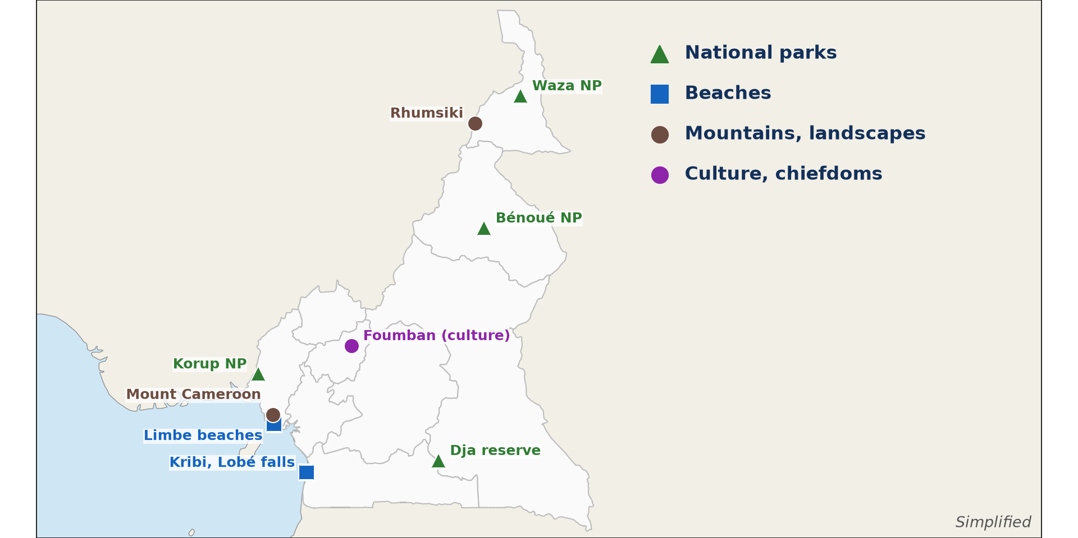
1. NATURAL RESOURCES
Activity 1
Main tourist sites of Cameroon.
Notes:
Activity 1. Look carefully at this diagram: main tourist sites of Cameroon. Observe every detail before I ask the question.

Slide 20
1. NATURAL RESOURCES
Activity 1: Question
Give two natural tourist sites and their regions.
Notes:
Here is the question for Activity 1: Give two natural tourist sites and their regions. Take one minute to think and write your answer in your rough notebook.

Slide 21
1. NATURAL RESOURCES
Activity 1: Answer
Waza park (Far North) and Kribi beaches (South).
Notes:
Let us check the answer together. Waza park (Far North) and Kribi beaches (South).

Slide 22
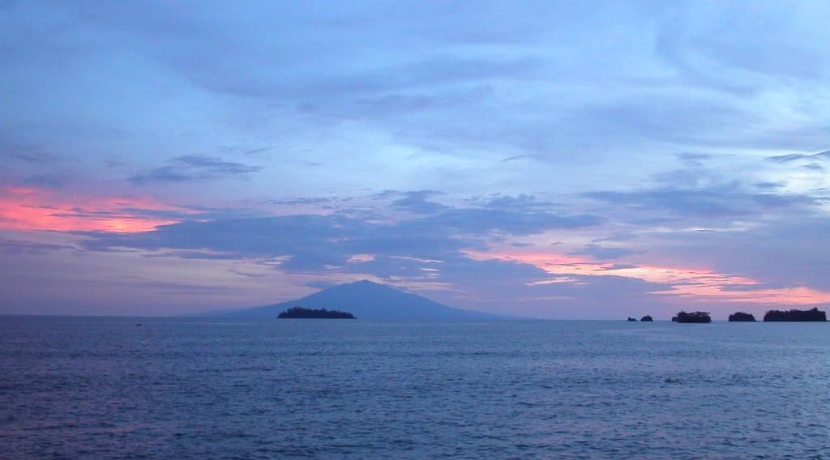
1. HUMAN RESOURCES
Activity 2
Sunset at Limbe.
Notes:
Activity 2. Look carefully at this picture: sunset at Limbe. Observe every detail before I ask the question.

Slide 23
1. HUMAN RESOURCES
Activity 2: Question
Give two human (cultural) tourist resources.
Notes:
Here is the question for Activity 2: Give two human (cultural) tourist resources. Take one minute to think and write your answer in your rough notebook.

Slide 24
1. HUMAN RESOURCES
Activity 2: Answer
Chiefdoms like Bafut and Foumban, and festivals like Ngondo.
Notes:
Let us check the answer together. Chiefdoms like Bafut and Foumban, and festivals like Ngondo.

Slide 25
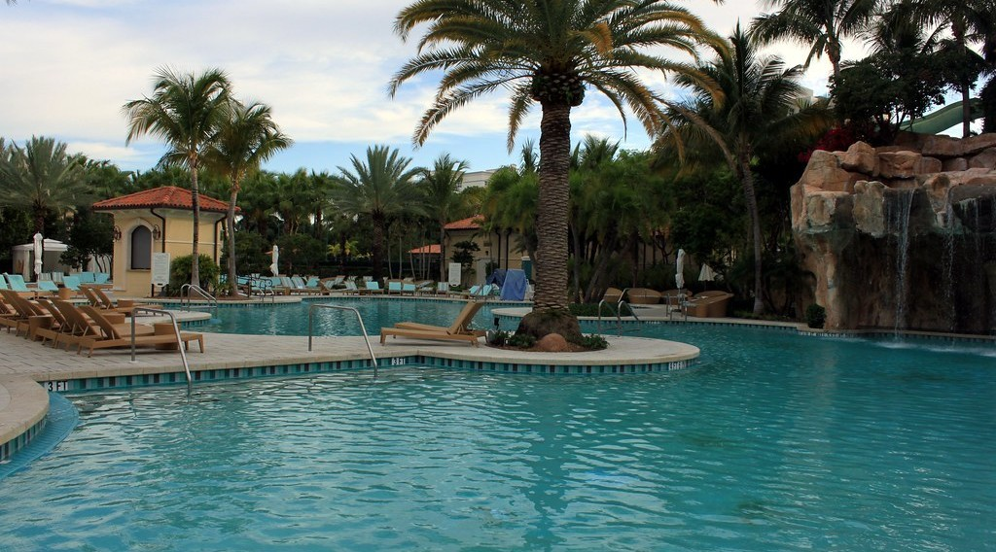
2. INFRASTRUCTURE
Activity 3
A hotel with a swimming pool.
Notes:
Activity 3. Look carefully at this picture: a hotel with a swimming pool. Observe every detail before I ask the question.

Slide 26
2. INFRASTRUCTURE
Activity 3: Question
Name three types of tourist infrastructure.
Notes:
Here is the question for Activity 3: Name three types of tourist infrastructure. Take one minute to think and write your answer in your rough notebook.

Slide 27
2. INFRASTRUCTURE
Activity 3: Answer
Hotels, roads and airports (also travel agencies).
Notes:
Let us check the answer together. Hotels, roads and airports (also travel agencies).

Slide 28

3. PROBLEMS
Activity 4
A bad road.
Notes:
Activity 4. Look carefully at this picture: a bad road. Observe every detail before I ask the question.

Slide 29
3. PROBLEMS
Activity 4: Question
Give three problems of tourism in Cameroon.
Notes:
Here is the question for Activity 4: Give three problems of tourism in Cameroon. Take one minute to think and write your answer in your rough notebook.

Slide 30
3. PROBLEMS
Activity 4: Answer
Bad roads, insecurity and poor advertising (also high costs).
Notes:
Let us check the answer together. Bad roads, insecurity and poor advertising (also high costs).

Slide 31

4. MEASURES AND IMPACTS
Activity 5
Wildlife in a national park.
Notes:
Activity 5. Look carefully at this picture: wildlife in a national park. Observe every detail before I ask the question.

Slide 32
4. MEASURES AND IMPACTS
Activity 5: Question
How can local communities benefit from tourism?
Notes:
Here is the question for Activity 5: How can local communities benefit from tourism? Take one minute to think and write your answer in your rough notebook.

Slide 33
4. MEASURES AND IMPACTS
Activity 5: Answer
By selling crafts, guiding tourists and sharing park income.
Notes:
Let us check the answer together. By selling crafts, guiding tourists and sharing park income.

Slide 34
BOARD SUMMARY
Board Summary
Topic: Geography of Cameroon
Sub-topic: Tourism in Cameroon
Further Study 7: Tourism Development in Cameroon
Notes:
Now we are going to copy the board summary. Write the title and the headings neatly in your notebooks. I will give you enough time for each slide, so do not rush.

Slide 35
BOARD SUMMARY
1. Tourist Resources of Cameroon
Cameroon, "Africa in miniature", has the following resources:
Natural resources: Beaches at Kribi and Limbe, Mount Cameroon and parks like Waza and Benue attract visitors. Waterfalls like the Lobé and crater lakes are also attractions.
Notes:
Let us copy Tourist Resources of Cameroon. Cameroon, "Africa in miniature", has the following resources. On this slide we have Natural resources. Write each point on a new line, with the key term first, and explain it in your own words when we revise. When you finish, we go to the next slide.

Slide 36
BOARD SUMMARY
1. Tourist Resources of Cameroon (continued)
Human resources: Chiefdoms, palaces and festivals show rich cultures. Foumban, Bafut, Rhumsiki and the Ngondo festival are famous.
Notes:
We continue with Tourist Resources of Cameroon. On this slide we have Human resources. Write each point on a new line, with the key term first, and explain it in your own words when we revise.

Slide 37
BOARD SUMMARY
1. Tourist Resources of Cameroon
Illustration: main tourist sites of Cameroon
Notes:
Now draw this illustration in your notebook: main tourist sites of Cameroon. Give it a title and label it clearly.

Slide 38
BOARD SUMMARY
2. Infrastructure and Tourists
Tourist infrastructure and flows are as follows:
Infrastructure: Hotels, airports, roads and travel agencies are concentrated in big towns. The Ministry of Tourism manages the sector.
Notes:
Let us copy Infrastructure and Tourists. Tourist infrastructure and flows are as follows. On this slide we have Infrastructure. Write each point on a new line, with the key term first, and explain it in your own words when we revise. When you finish, we go to the next slide.

Slide 39
BOARD SUMMARY
2. Infrastructure and Tourists (continued)
Sources and destinations: Most tourists come from France, other European countries and Africa. Business tourism is common in Douala and Yaoundé.
Notes:
We continue with Infrastructure and Tourists. On this slide we have Sources and destinations. Write each point on a new line, with the key term first, and explain it in your own words when we revise.

Slide 40
BOARD SUMMARY
3. Problems of Tourism in Cameroon
Tourism in Cameroon faces the following problems:
Infrastructure problems: Bad roads and few hotels in rural areas make sites hard to reach. Hotels and flights are also costly.
Notes:
Let us copy Problems of Tourism in Cameroon. Tourism in Cameroon faces the following problems. On this slide we have Infrastructure problems. Write each point on a new line, with the key term first, and explain it in your own words when we revise. When you finish, we go to the next slide.

Slide 41
BOARD SUMMARY
3. Problems of Tourism in Cameroon (continued)
Other problems: Insecurity in some regions keeps tourists away. Poor advertising means that the sites are little known abroad.
Notes:
We continue with Problems of Tourism in Cameroon. On this slide we have Other problems. Write each point on a new line, with the key term first, and explain it in your own words when we revise.

Slide 42
BOARD SUMMARY
4. Measures and Impacts
Tourism can be promoted and has the following impacts:
Measures: The government can improve roads, security and advertising abroad. Communities and individuals can welcome, guide and protect visitors.
Notes:
Let us copy Measures and Impacts. Tourism can be promoted and has the following impacts. On this slide we have Measures. Write each point on a new line, with the key term first, and explain it in your own words when we revise. When you finish, we go to the next slide.

Slide 43
BOARD SUMMARY
4. Measures and Impacts (continued)
Impacts: Tourism brings jobs, income and pride in local culture. It can also pollute sites and disturb wildlife.
Notes:
We continue with Measures and Impacts. On this slide we have Impacts. Write each point on a new line, with the key term first, and explain it in your own words when we revise.

Slide 44
FORMATIVE EVALUATION
Evaluation 1
Give two natural and two cultural tourist resources of Cameroon.
Notes:
Now let us check what you have understood. Question 1: Give two natural and two cultural tourist resources of Cameroon. Answer in your exercise book.

Slide 45
FORMATIVE EVALUATION
Expected Answer
Natural: Waza, Kribi. Cultural: Foumban palace, Ngondo festival.
Notes:
The expected answer is: natural: Waza, Kribi. Cultural: Foumban palace, Ngondo festival. If you got it right, well done.

Slide 46
FORMATIVE EVALUATION
Evaluation 2
Give two measures to promote tourism in Cameroon.
Notes:
Now let us check what you have understood. Question 2: Give two measures to promote tourism in Cameroon. Answer in your exercise book.

Slide 47
FORMATIVE EVALUATION
Expected Answer
Improve roads and security; advertise abroad.
Notes:
The expected answer is: improve roads and security; advertise abroad. If you got it right, well done.

Slide 48
REMEDIATION
Remediation
Fill in the blanks:
Waza park is in the ______ Region.
The beaches of ______ are in the South Region.
Tourism is managed by the Ministry of ______.
Notes:
For those who need more practice, fill in the blanks in your exercise book. The answers are: number 1, Far North; number 2, Kribi; number 3, Tourism.

Slide 49
HOMEWORK
Homework
Prepare a short advertisement for a tourist site in your region.
Notes:
For your homework: Prepare a short advertisement for a tourist site in your region. We shall correct it at the beginning of our next lesson.

Slide 50
NEXT LESSON
Next Lesson
Our next lesson will be on:
Lesson 1: Pollution
Notes:
Our next lesson will be on Lesson 1: Pollution. Thank you for your attention, and see you next time.

Slide 51
BILINGUAL GAME
Bilingual Game (Jeu Bilingue)
English | Français
National park | Le parc national
Chiefdom | La chefferie
Festival | Le festival
Craft | L'artisanat
Guide | Le guide
Advertising | La publicité
Notes:
Let us play the bilingual game. I say a word in English, and you give me the French word. Then we do the reverse.

Slide 52
LOGBOOK
Official Logbook (1/2)
Module / Topic | Geography of Cameroon
Lesson Title | Further Study 7: Tourism Development in Cameroon
Expected Learning Outcomes | Describe the tourist resources and infrastructure of Cameroon. Explain the problems of tourism. Propose measures to promote tourism and assess its impacts.
Competence | Learners are able to describe tourism in Cameroon, its problems and ways to promote it.
Notes:
I record this information in the official logbook of the class after the lesson.

Slide 53
LOGBOOK
Official Logbook (2/2)
Matter Taught | Tourist Resources of Cameroon; Infrastructure and Tourists; Problems of Tourism in Cameroon; Measures and Impacts.
Evaluation | Formative evaluation and remediation exercise.
Homework | Prepare a short advertisement for a tourist site in your region.
Enrolment / Present / Absent | ____ / ____ / ____
Achievement | To be completed after the lesson.
Notes:
I complete the second page of the logbook: the matter taught, the evaluation, the homework and the attendance.

Slide 54
TEACHER'S NOTE
Teacher's Note
Timing: Homework correction, plan, objectives 8 min | Recall, situation, action 10 min | 5 activities 30 min | Board summary (copying) 30 min | Evaluation, remediation 10 min | Homework, next lesson 5 min | Logbook 7 min
Without the projector (Activity 1): read the map.
Without the projector (Activity 2): list cultural sites.
Without the projector (Activity 3): list hotels in your town.
Without the projector (Activity 4): list problems.
Without the projector (Activity 5): discuss community tourism.
Notes:
This slide is for me, the teacher: it gives the timing of the lesson and what to do if the projector is not available.

Slide 55
REFERENCES
References
National Geography Syllabus, MINESEC/IGE/IP-SS, 2019 — Module 6 (Economic Geography).
Photo, Activity 2: “Sunset in Limbe” by visulogik, CC BY 2.0, via Flickr (https://www.flickr.com/photos/55671677@N00/2202334428)
Photo, Activity 3: “Laguna Pool” by Prayitno / Thank you for (12 millions +) view, CC BY 2.0, via Flickr (https://www.flickr.com/photos/34128007@N04/14216582552)
Photo, Activity 4: “Cameroon - UN Women's Gender Road Project” by UN Women Gallery, CC BY-NC-ND 2.0, via Flickr (https://www.flickr.com/photos/51431730@N04/40672356003)
Photo, Activity 5: “African Bush Elephants, Maasai Mara” by Ray in Manila, CC BY 2.0, via Flickr (https://www.flickr.com/photos/21186555@N07/50627864261)
Diagrams and animations: drawn for this lesson (Geography Department).
Notes:
These are the references and picture credits used to prepare this lesson.

